Slide 1

Library of aristotle
Presentation by Bogdan Draghici

Slide 2
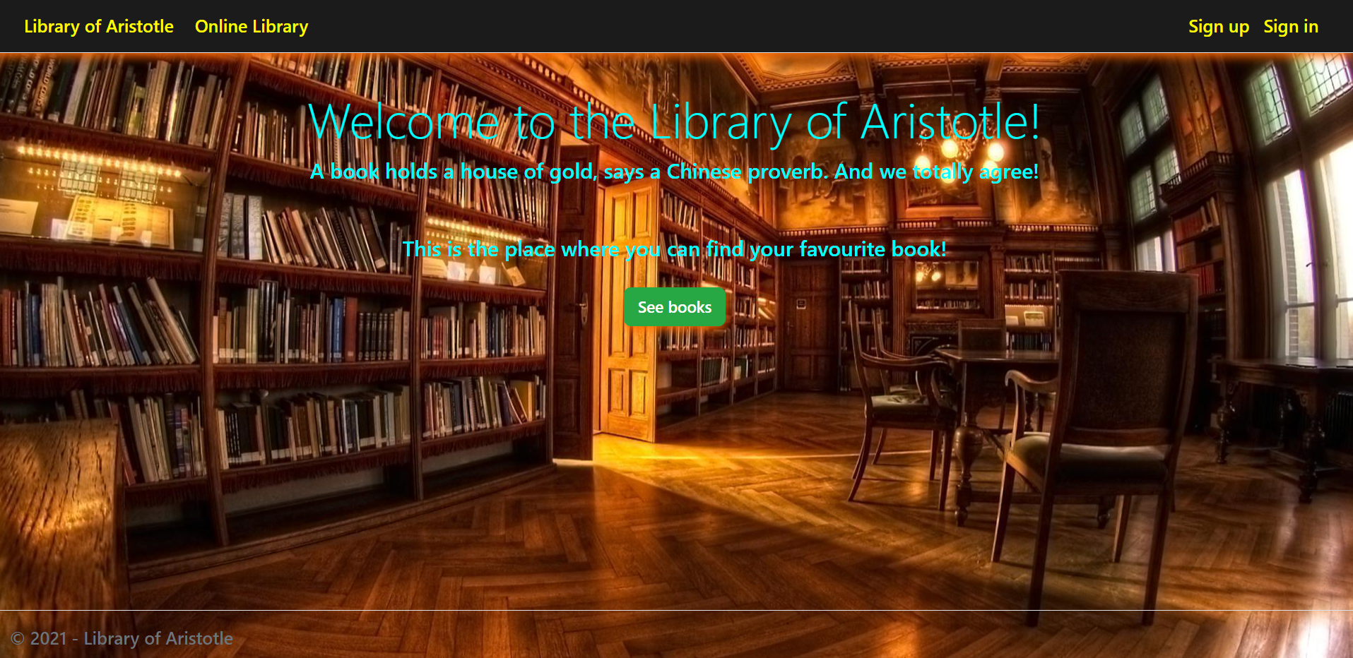
Home page and visitor navigation bar
Here the user has a small description of the application and can choose to:
See books available in our collection of libraries
Sign in his/her personal account
Sing up on our website

Slide 3
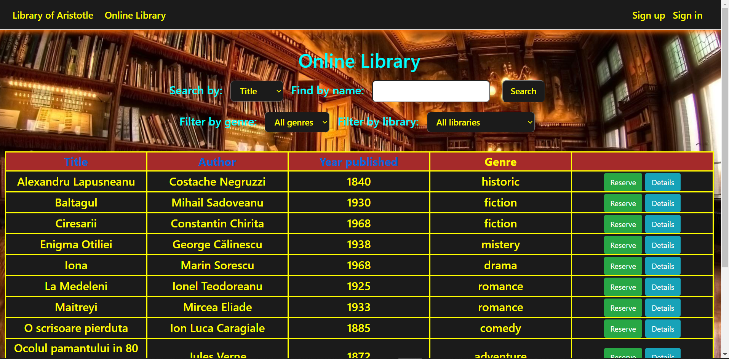
Online library
On this page, any visitor can:
Search books by title or author
Filter books by genre or libraries that have them
Sort books by title, author or year published
See books description
Reserve books

Slide 4
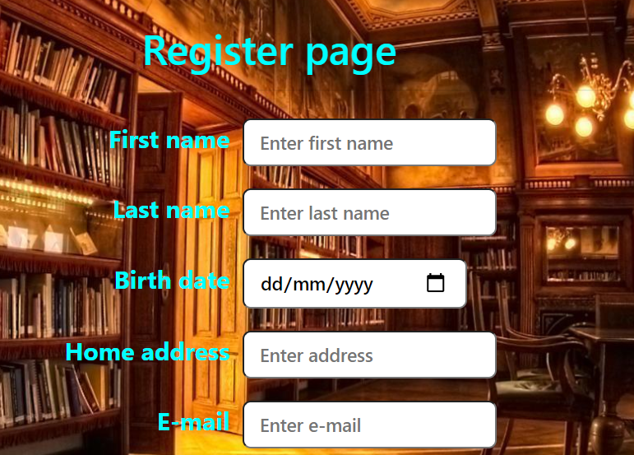
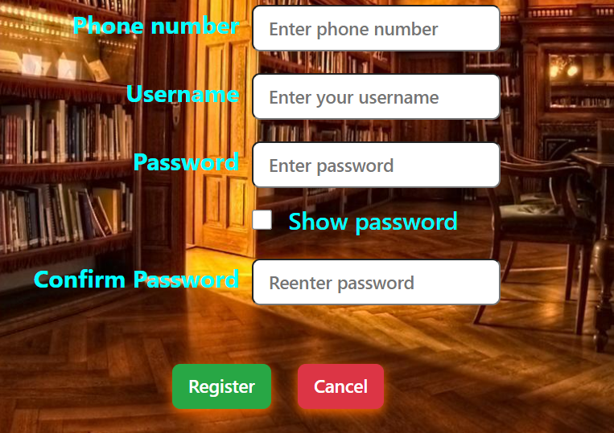
Register page
Here the user can create his/her personal reader account.
In case some fields are not completed, the user will be notified. Can also choose to see the chosen password.

Slide 5
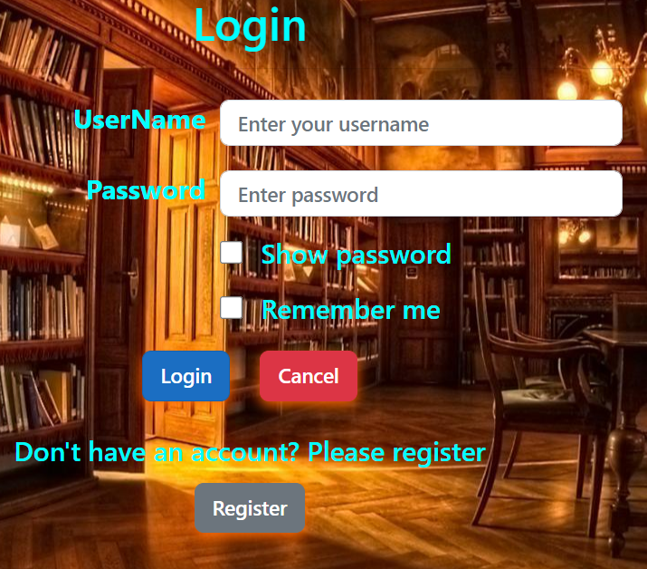
Login page
The user can login in the account previously created.
In case the credentials are wrong, the user will be notified.
Can also choose to see the type password and to be remembered by the website for 3 days.

Slide 6
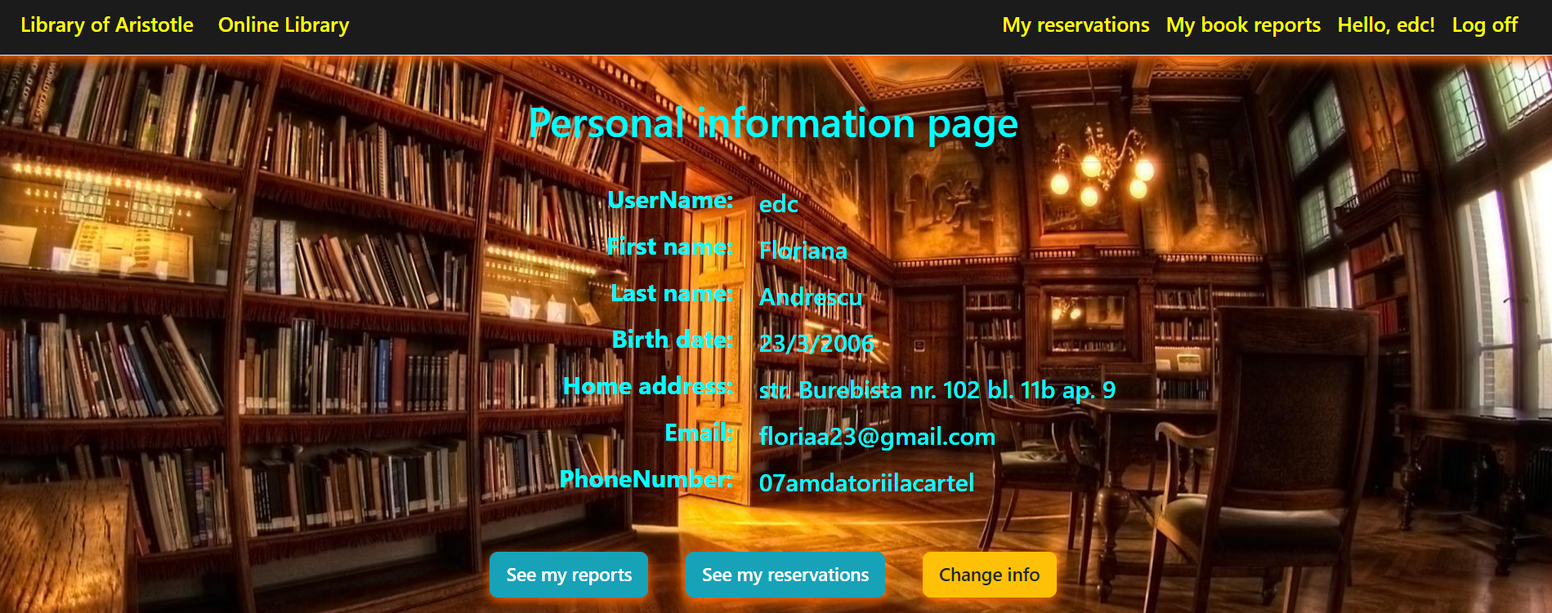
Personal information page
When logged in, the reader can see its personal information, and make reservations. He/She can also see his/her reservations and reports, choose to change personal information and log out from the application.

Slide 7
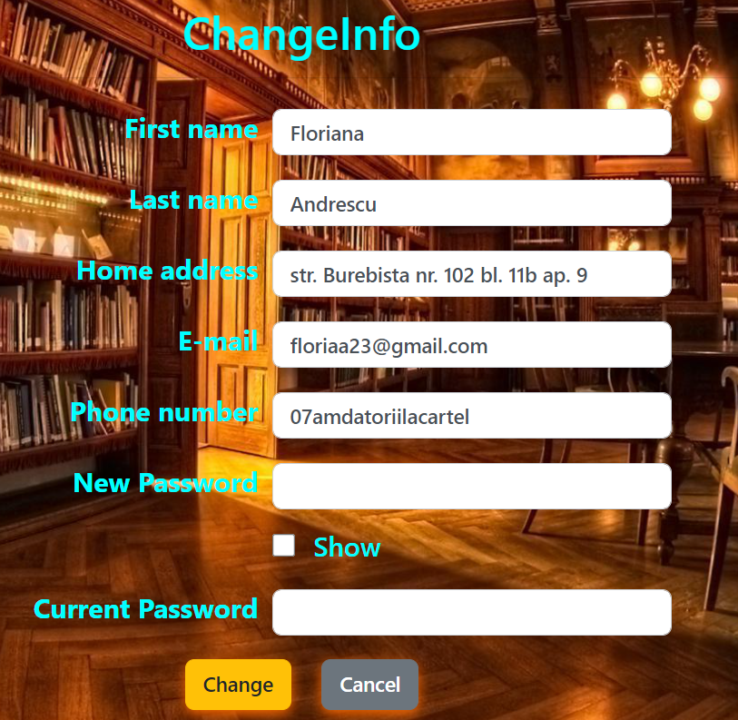
Change personal information
The reader can change some of his/her personal information and the account’s password.
Must confirm the current password first in order for the changes to take place.
The reader will be notified in case the updated information does not meet certain conditions.

Slide 8
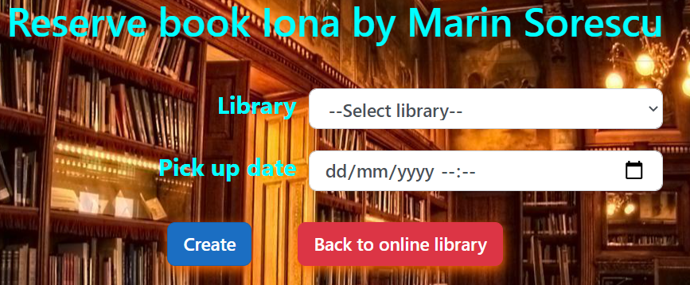
Book reservation page
Here, the user signed in as a reader will choose from the list of libraries in which the book is available, the one where he wants to go to pick it up. Also, must choose a pickup date for the reservation.

Slide 9
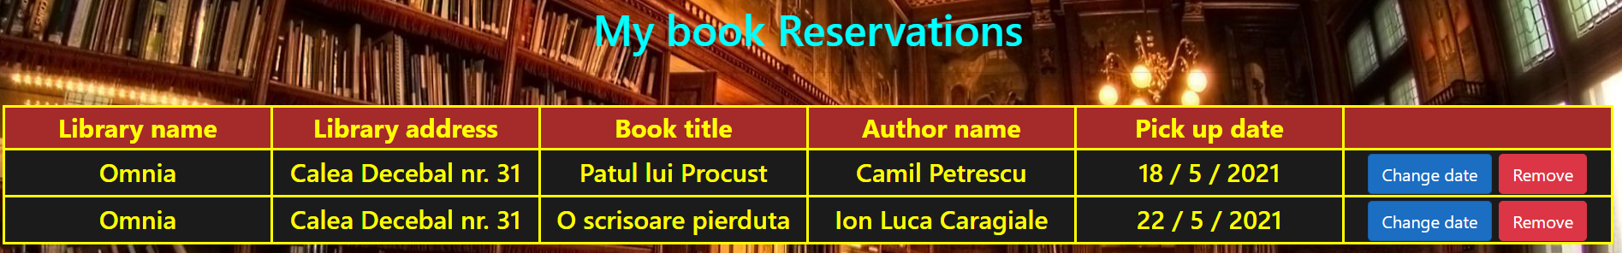
Reader’s reservations page
On this page, the reader can see useful information about its personal reservations and can choose to remove any reservation or change the pickup date.

Slide 10
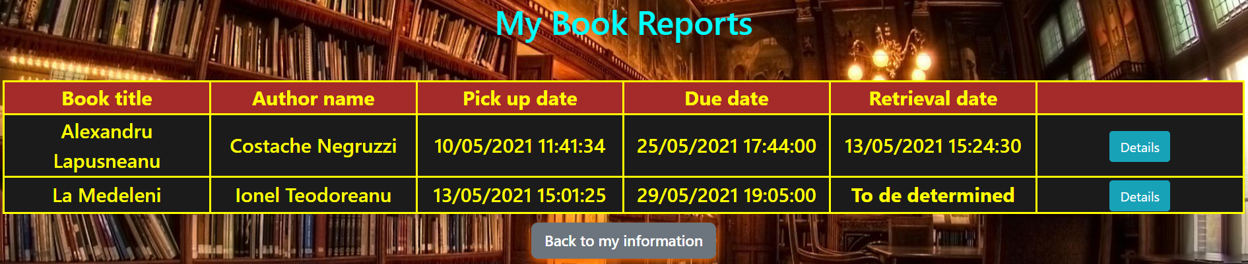
Reader’s book reports
After the reader picks up the book, a librarian will create a report for that book that can be seen by the reader and all librarians. Here the reader can see useful information about the report, such as due date and what books he/she hasyet to return to the library.

Slide 11

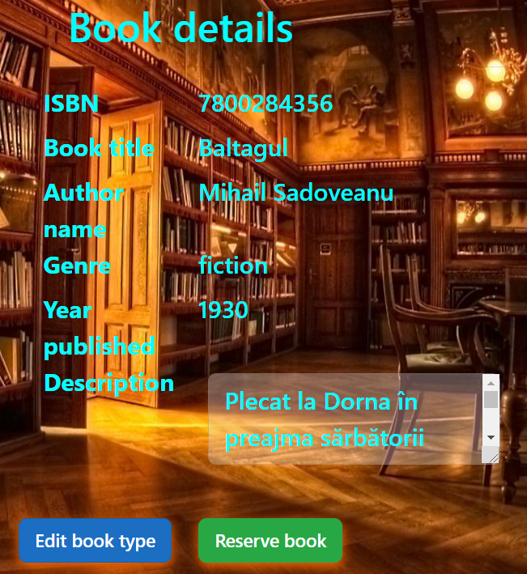
Book details
In this page are given informations about a specific book to any user.
A librarian can also edit this information.

Slide 12
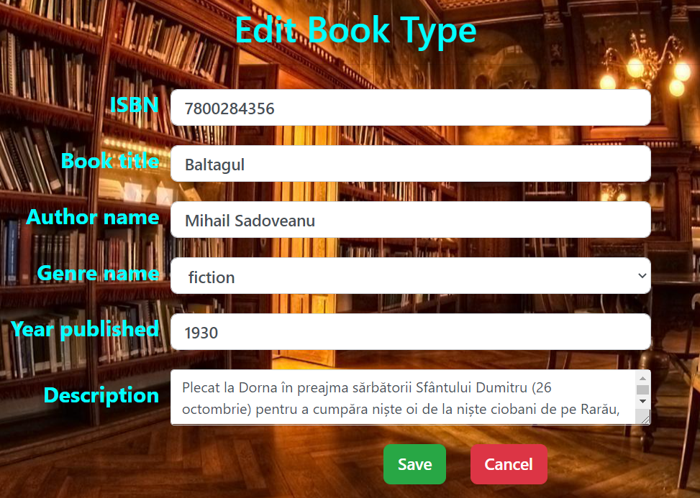
Edit book type
The librarian can edit the following fields shown.
In case the new information does not meet certain conditions, the librarian is notified. In case it does, the updated information is successfully saved in the database.

Slide 13
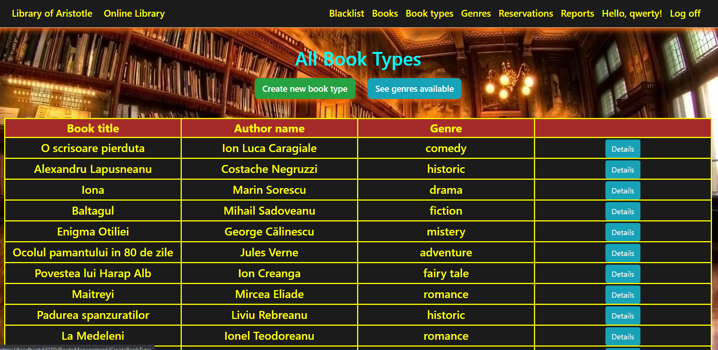
Librarian functionality
A librarian has access to additional functionalities such as:
See and create reports
See and remove reservations (if expired)
See and add genres
See and edit book types
See, add and remove books
See, add and remove users from blacklist

Slide 14
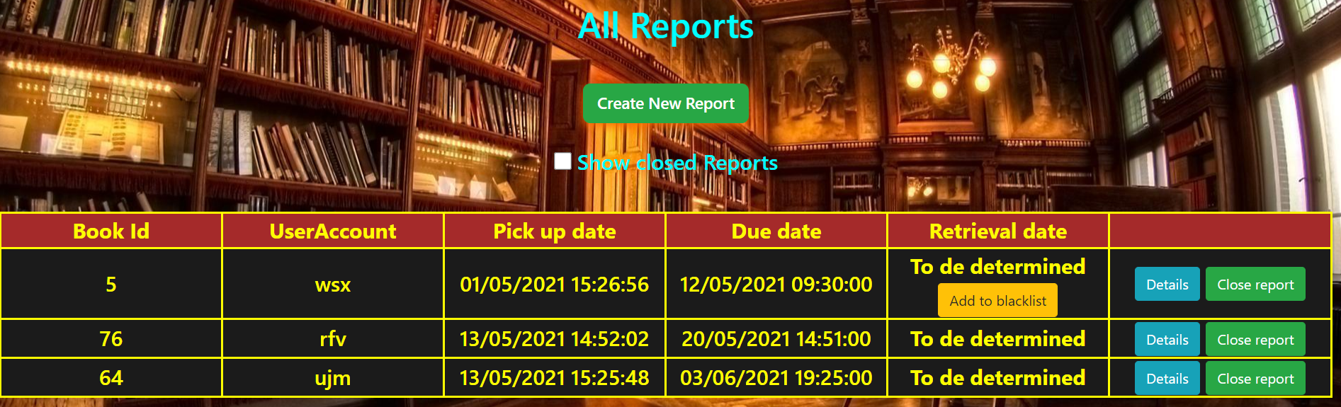
Librarian page for reports
On reports page, the librarian can
Create new report
See open or all reports
Close reports
See report details
Close open report
Add users to blacklist in case they passed the due date

Slide 15
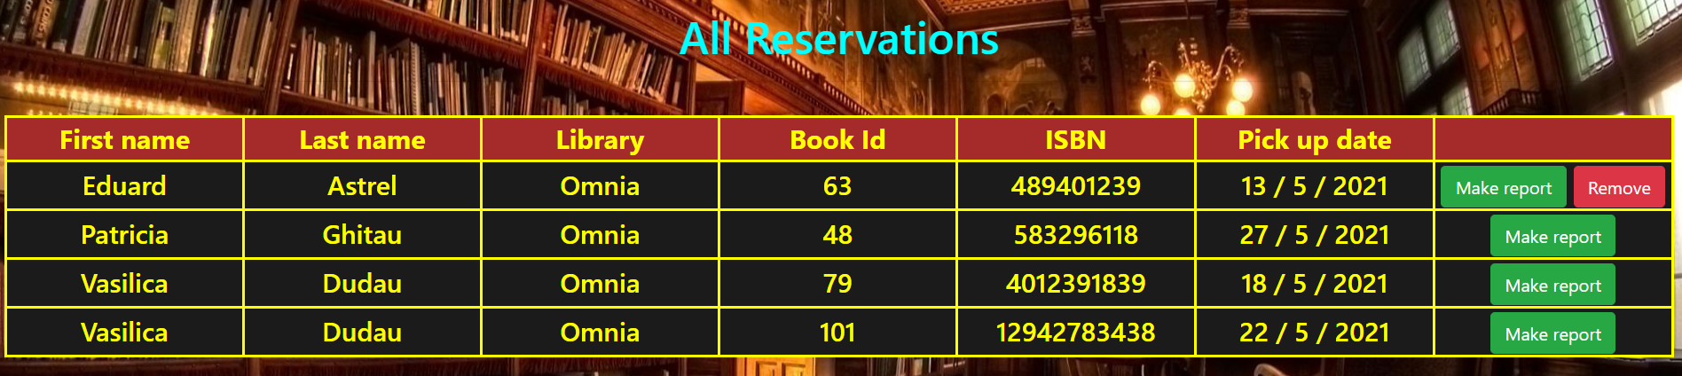
Librarian page for reservations
The librarian can see all reservations for the library where he/she works, create reports from them, or remove them in case the pickup date has passed.

Slide 16
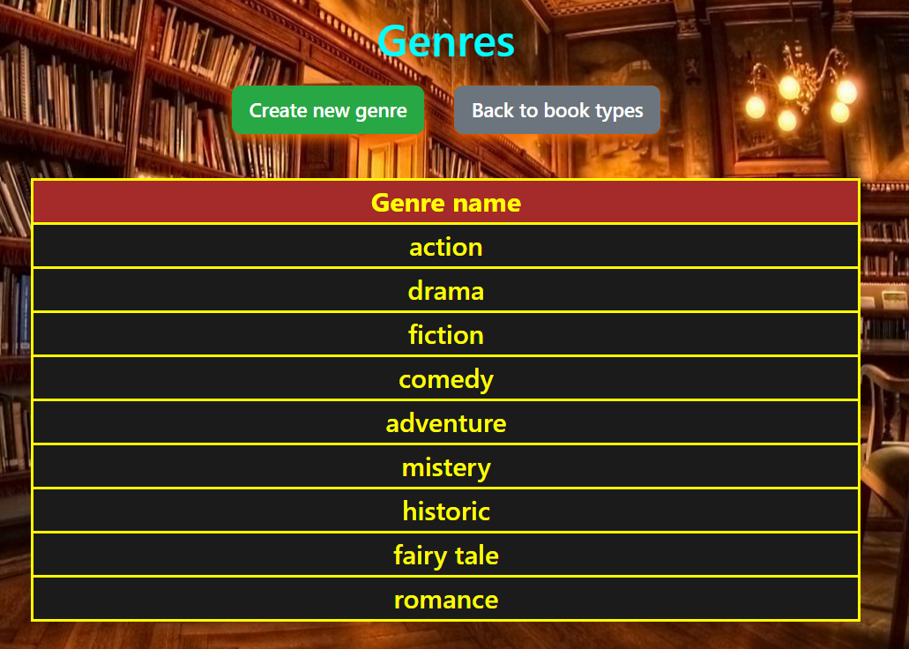
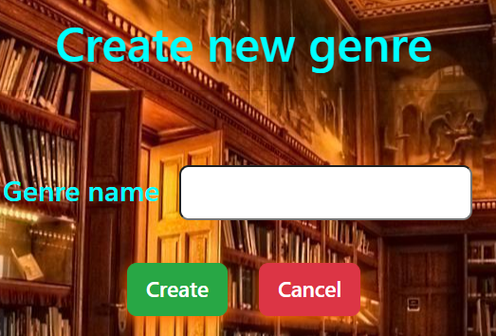
Genres peges
Here the librarian can see and add new genres

Slide 17
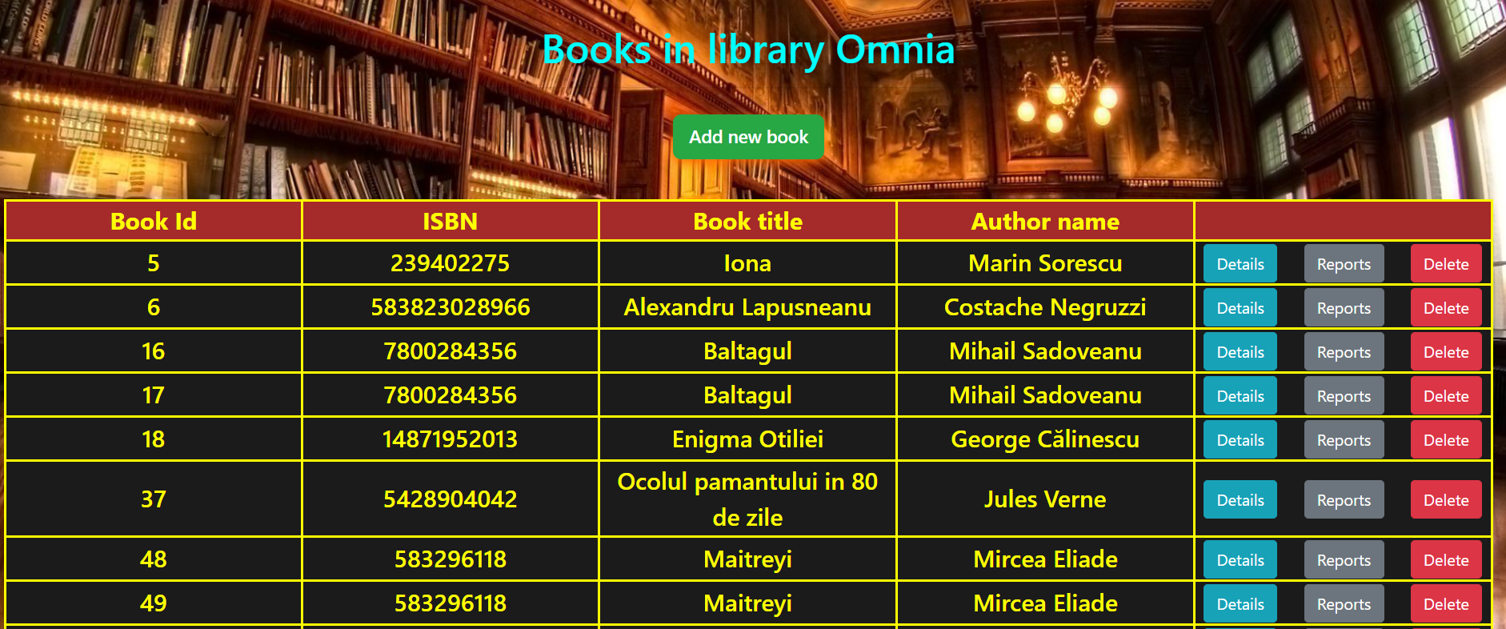
Books in library
Here, the librarian can:
See all physical books in the library where he/she works
Add new books
Remove books from the library
See all existent reports for each physical book

Slide 18
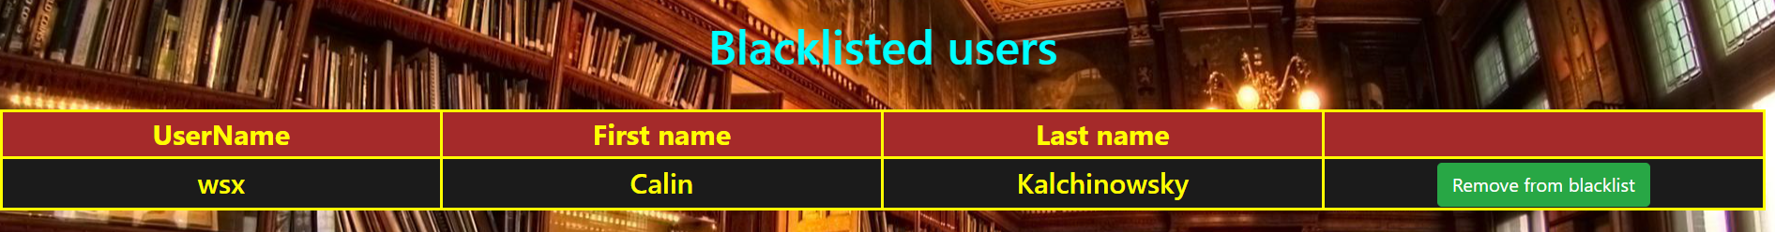
Blacklist page
All librarians can see the users blacklisted due to passing the book’s deadline. They can also remove those users in case they consider so.

Slide 19
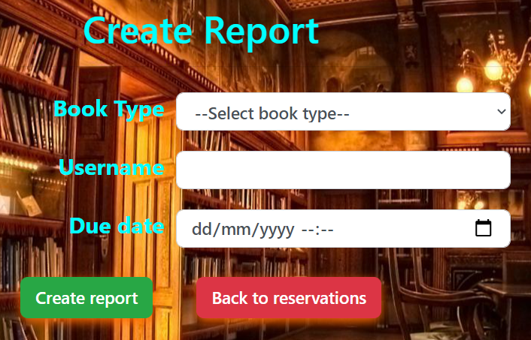
Create report page
In case the librarian wants to create a report for a reader that did not have a reservation, the shown fields must be completed.
In case any of those fields does not meet some conditions or the user is not found, the librarian is notified.

Slide 20
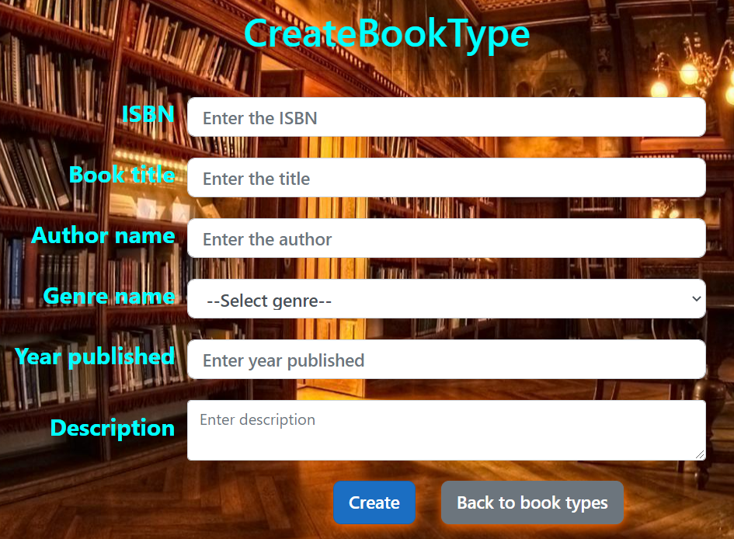
Create book type page
The librarian can create a new book type to be used by any librarian in any library by completing the fields shown.

Slide 21
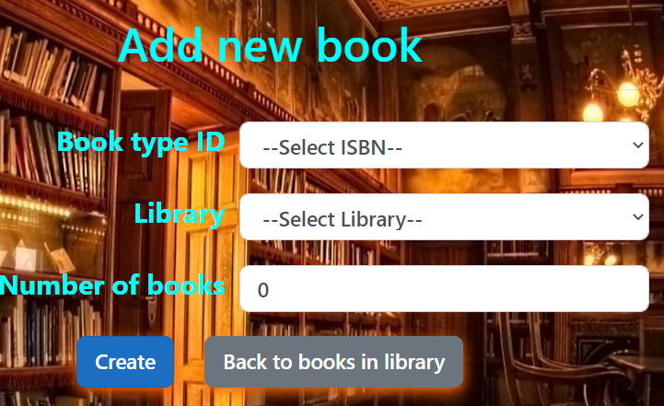
Add books page
When a new stock of books comes to the library, the librarian can add more of them by ISBN.
This will also show the ID for every specific book that was created, in order to be uniquely labeled.

Slide 22
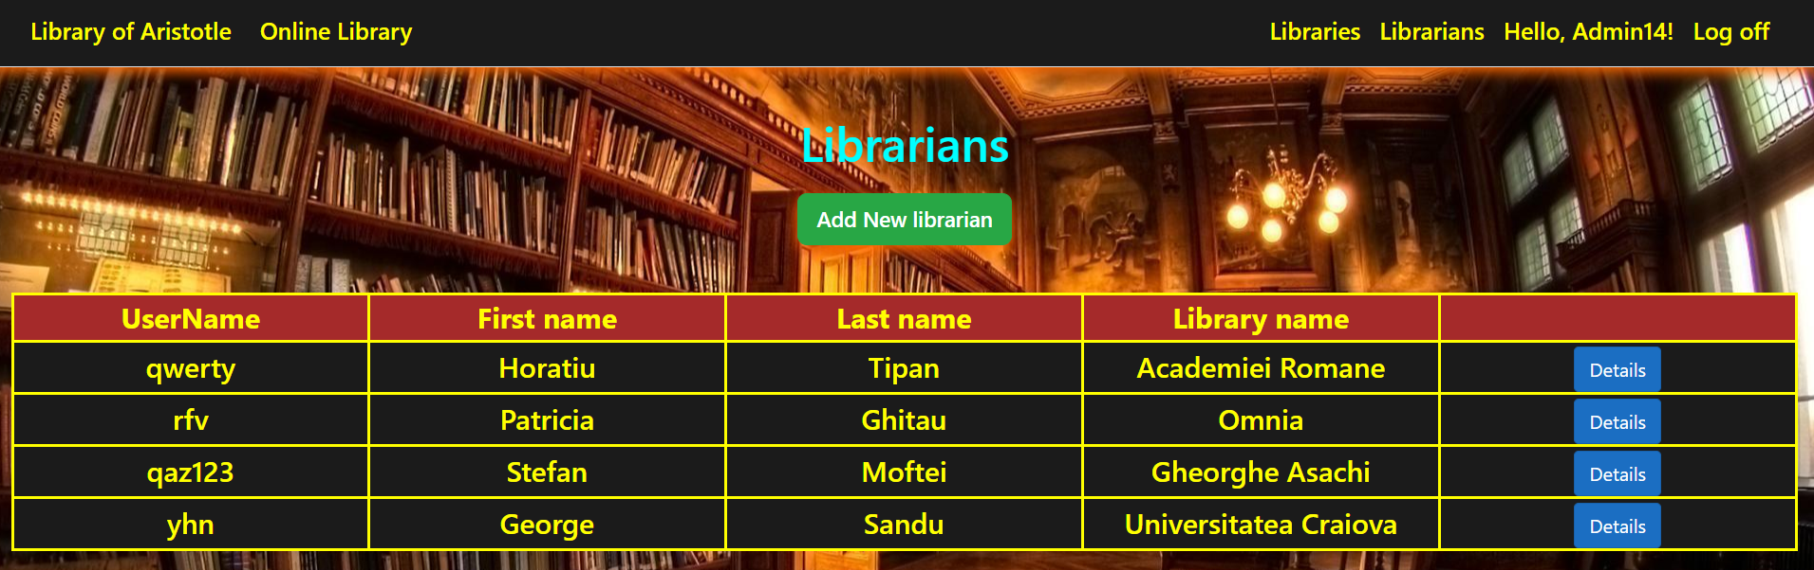
Librarians’ page
When logged in, the administrator can add librarians, see their personal information, and remove them.

Slide 23
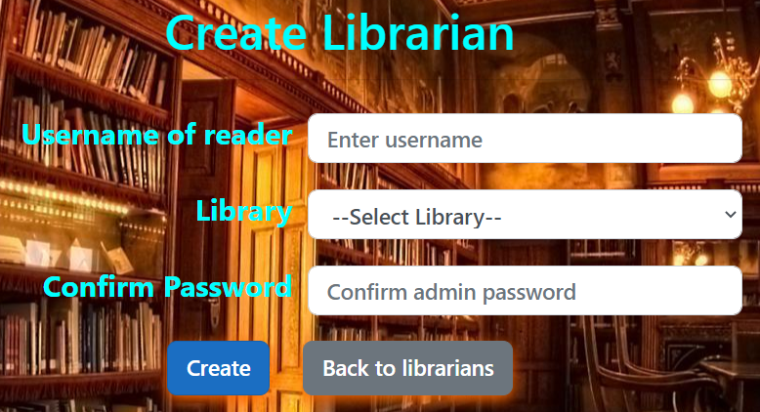
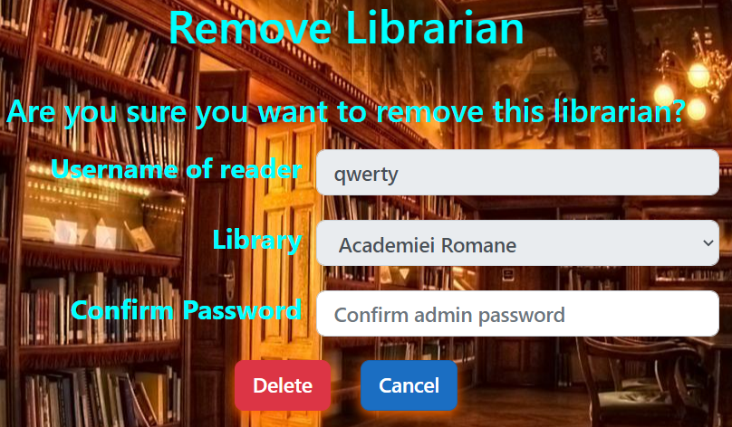
Create and remove librarians
When creating or removing a librarian, the administrator must confirm its password. When the username introduced is not found or the passwords is incorrect, the administrator is notified in this aspect.

Slide 24
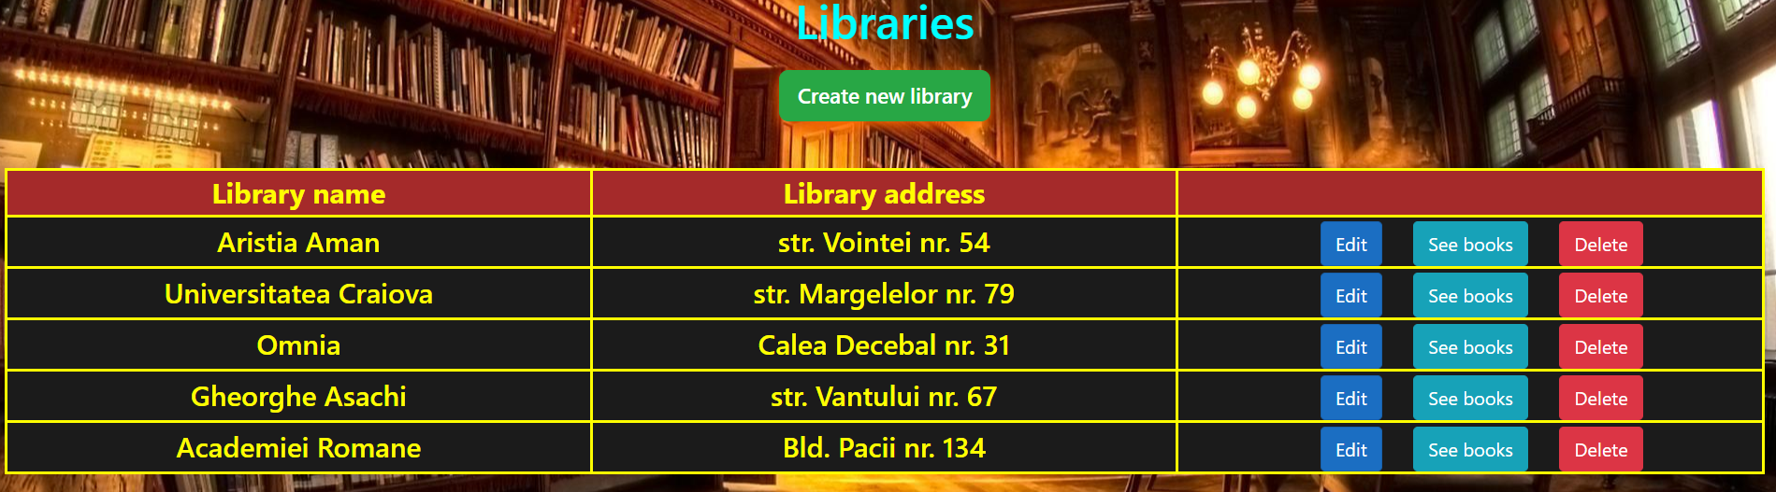
Libraries page
The administrator can see, create and remove libraries similarly to librarians, but the libraries can also be edited. As the librarian, the administrator can see all physical books, but can choose to do so in any library.

